Slide 1
University of Diyala
College of Engineering
Department of Electronics Engineering
Course Number: U103
Course Name: Computer Science
Lecture (9)
Asst. Lect. Wurod Qasim Mohamed

Slide 2
Microsoft office Excel Work Sheet

Slide 3
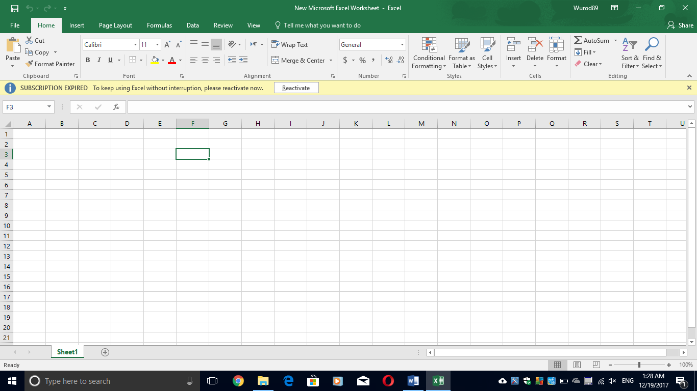

Slide 4
Tool bars of File, Home, Insert, Page layout, Review, and View are almost the same as Microsoft office Word with replacing “Document” with “Worksheet”.
There are two more tool bars in this program:
Tool bar of Formulas:
Insert function (Shift + F3): help you to insert a function in a selected cell.
Function Library: help you to pick a function to your worksheet in a selected cell.

Slide 5
Tool bar of Data:
Get External Data: help you to import data from the following:
Access
Website
Text
Other source

Slide 6
Sort and Filter:
Sort: help you to find the values quickly by sorting your data as follows:
Sort A to Z
Sort Z to A
Filter (Ctrl + Shift + L): help you to choose the filtering options for a selected column as follows:
Clear: to clear all filtering option.
Reapply (Ctrl+Alt+L)
Advanced: to apply filter with complex criteria.

Slide 7
Practical Laboratory Part

